Slide 1
UTSA CS 4593: CS-CURE
Course-based Undergraduate Research Experience in CS
Amanda Fernandez, Ph.D
UTSA Department of Computer Science
Spring 2024

Slide 2
Week 12:
The Peer Review Process

Slide 3
UTSA CS-CURE
Week 12
Objectives:
Understand the peer review process for publishing research
Learn from expert(s) in diverse fields within CS
Deliverables:
Guest Lecture Survey (in-class Thursday)

Slide 4
Peer Review:
The basics

Slide 7
https://shitmyreviewerssay.tumblr.com/

Slide 8
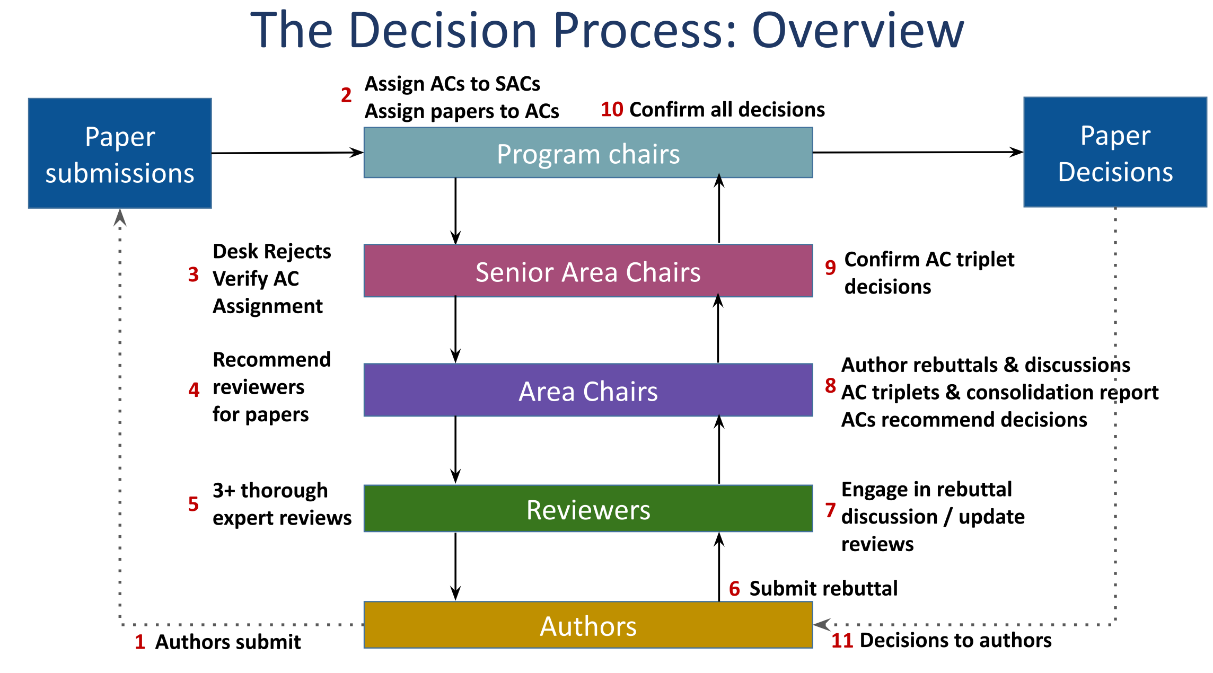
Papers Reviewed

Slide 9
From “How to write a good review?”, CVPR workshop 2024

Slide 10
The Peer Review Process
Paper registration
Paper submission
Assignments (AC & reviewers)
Initial reviews
Rebuttals
Discussion
Final Reviews
Final decisions & notifications

Slide 11
Types of Reviews
Peer Review
Volunteers who are experts in the community dedicate time to reviewing each year.
Each paper receives 3 to 6 peer reviews.
Image source: Editage Insights

Slide 12
Ratings & Scales
Peer Review
Strong reject
Reject
Weak Reject
Borderline
Weak Accept
Accept
Strong accept
Final decisions are often rated as above.
Reviewers typically also rate (e.g. from 1 to 5) the:
Novelty
Applicability to community interests
Clarity of writing
The reviewers’ own expertise in the field

Slide 13
Ethics for Reviewing Papers
Peer Review
Respect anonymity in the review process
Protect ideas
Avoid conflicts of interest
Be professional
From “How to write a good review?”, CVPR workshop 2024

Slide 14
Different Kinds of Evaluation
Peer Review
Different types of papers should be evaluated differently!
Paper Contribution | Evaluation
Potentially transformative idea | Basic proof-of-concept
Established problem, plausible idea | Benchmark results
Weird, overly complex, implausible, and/or seemingly incremental | Extraordinary results (Needs to be scrutinized carefully)
Position piece or theory paper | No experiments, extensive justification
From “How to write a good review?”, CVPR workshop 2024

Slide 15
Peer Review:
Common Platforms for CS Venues

Slide 16
Common Platforms for Peer Review
Peer Review
OpenReview.net
Microsoft CMT
EasyChair

Slide 17
Your Profile as a Researcher
Peer review platforms
Most often all co-authors must have a profile in the submission system.
Confirms your authorship of the submission.
Identify reviewers who would be a conflict of interest.
Identify your areas of research expertise.

Slide 18
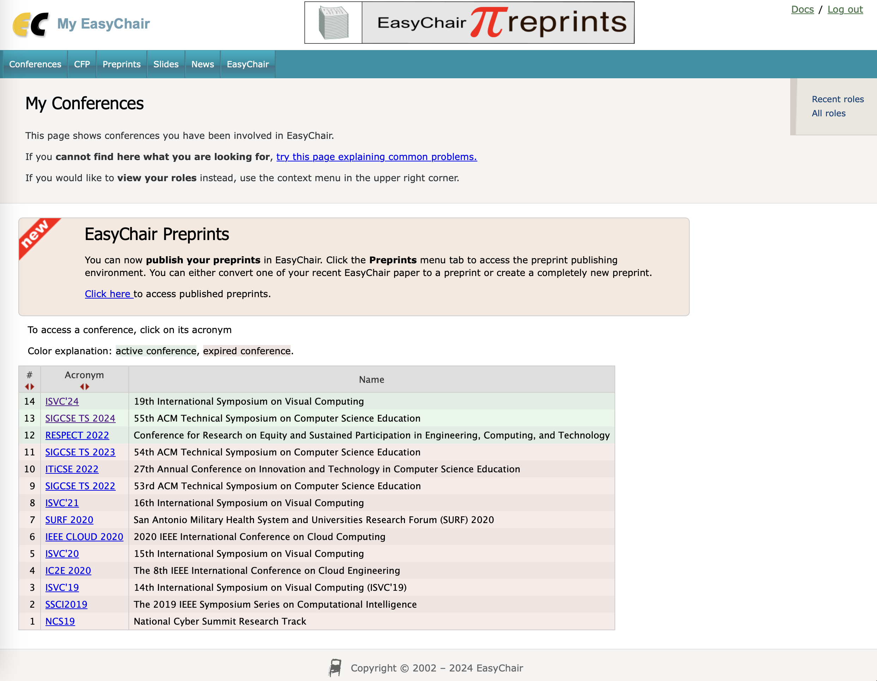

Slide 19
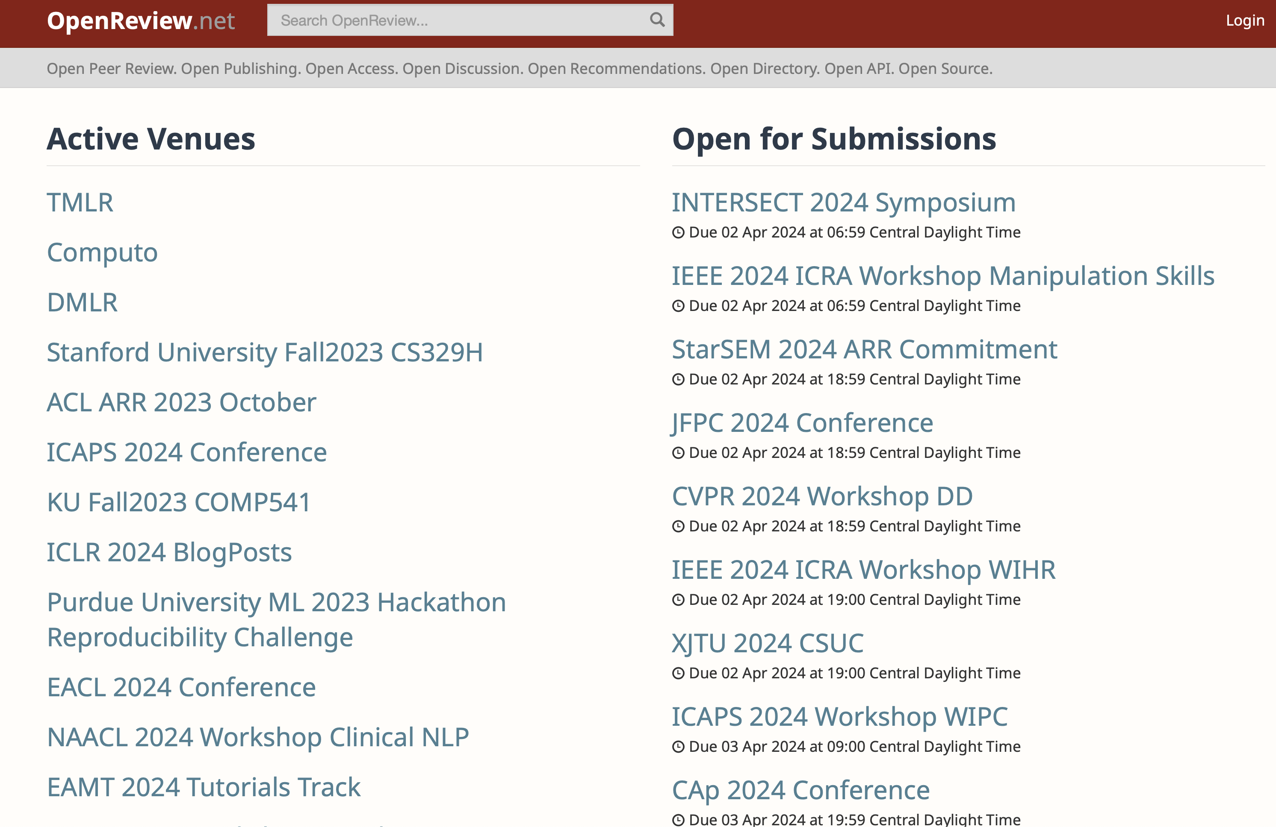

Slide 20
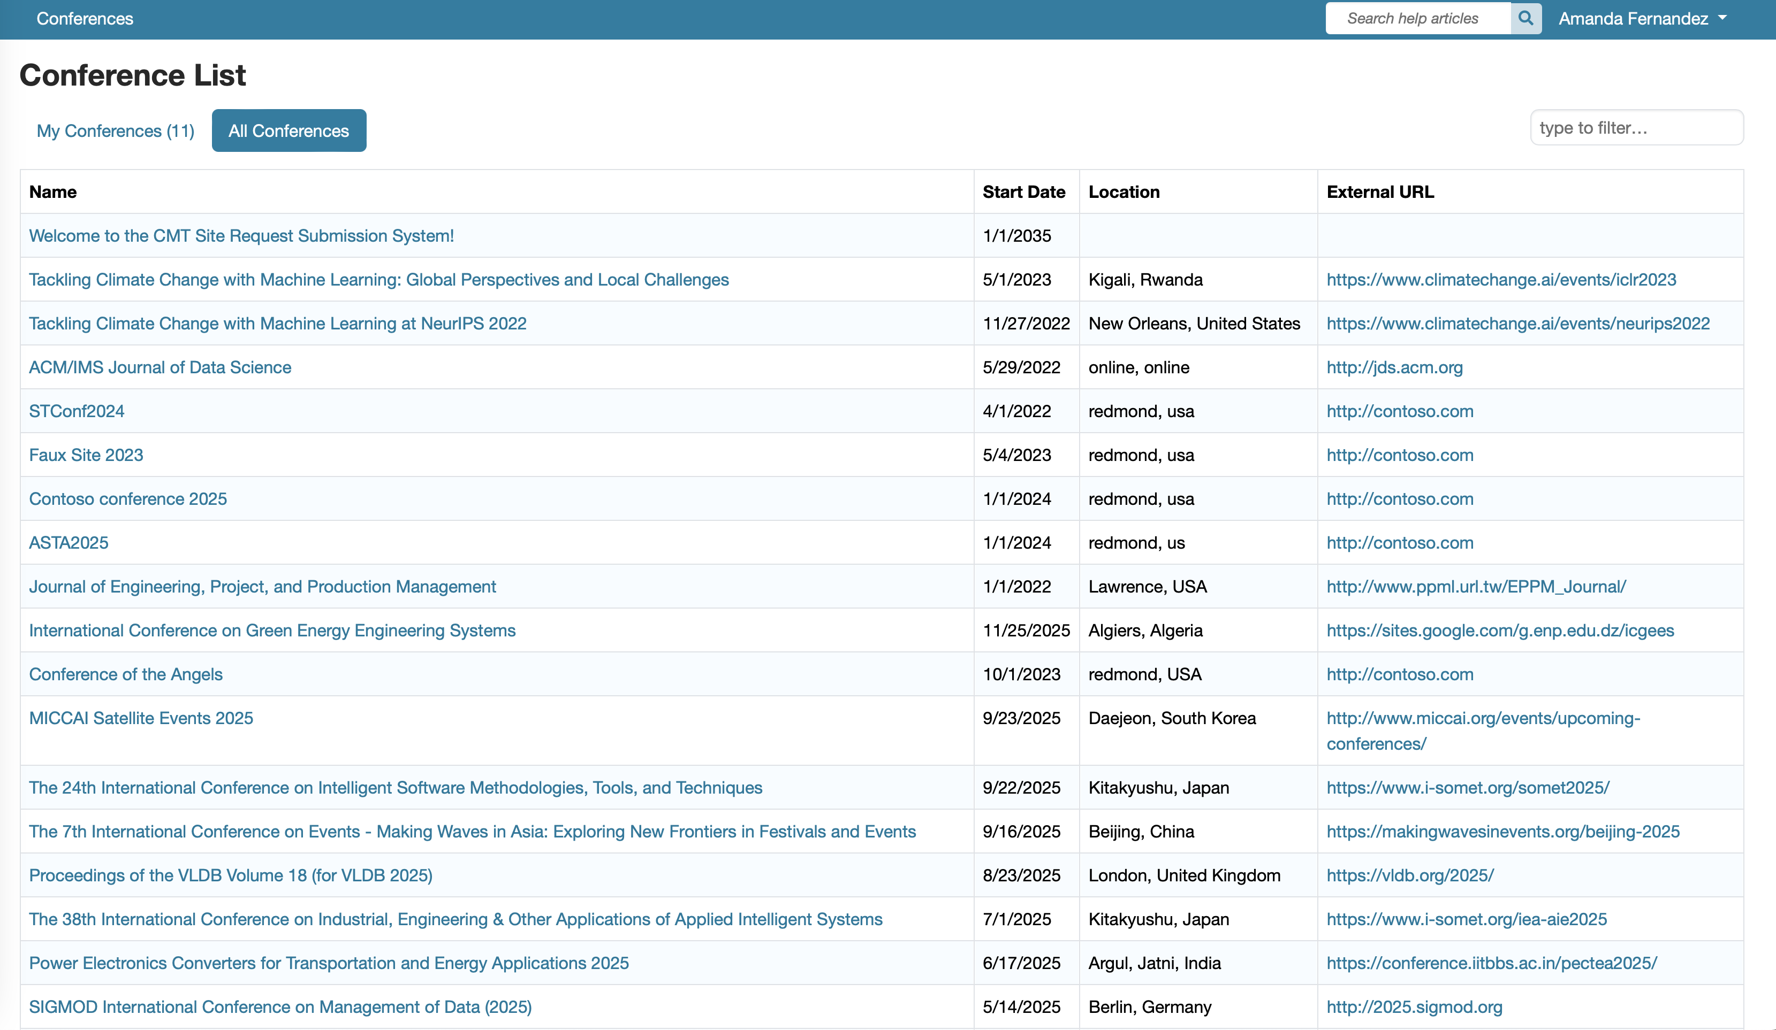
Microsoft CMT

Slide 21
Peer Review:
How to be a good reviewer

Slide 22
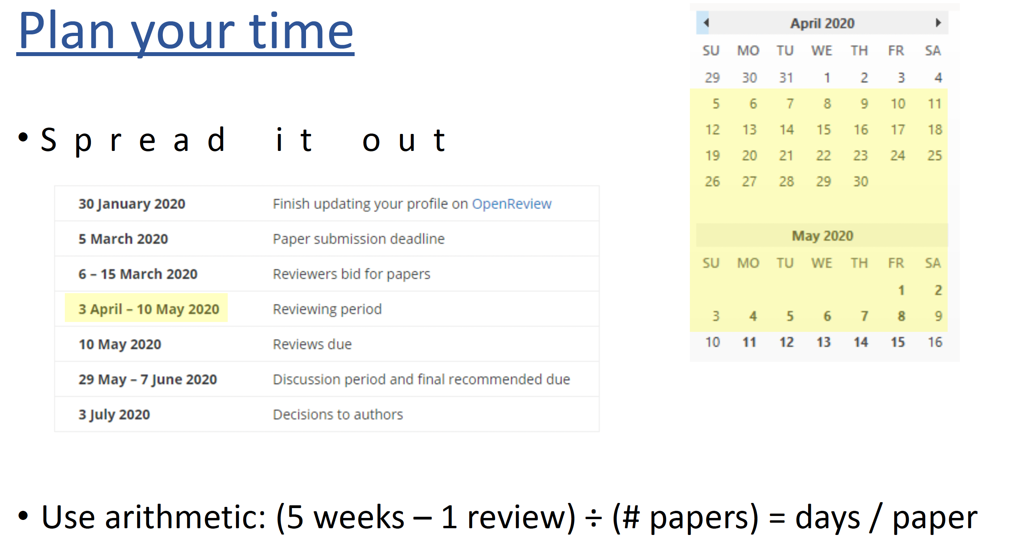
From Richard Szeliski, “How to write a good review?”, CVPR workshop 2020

Slide 23
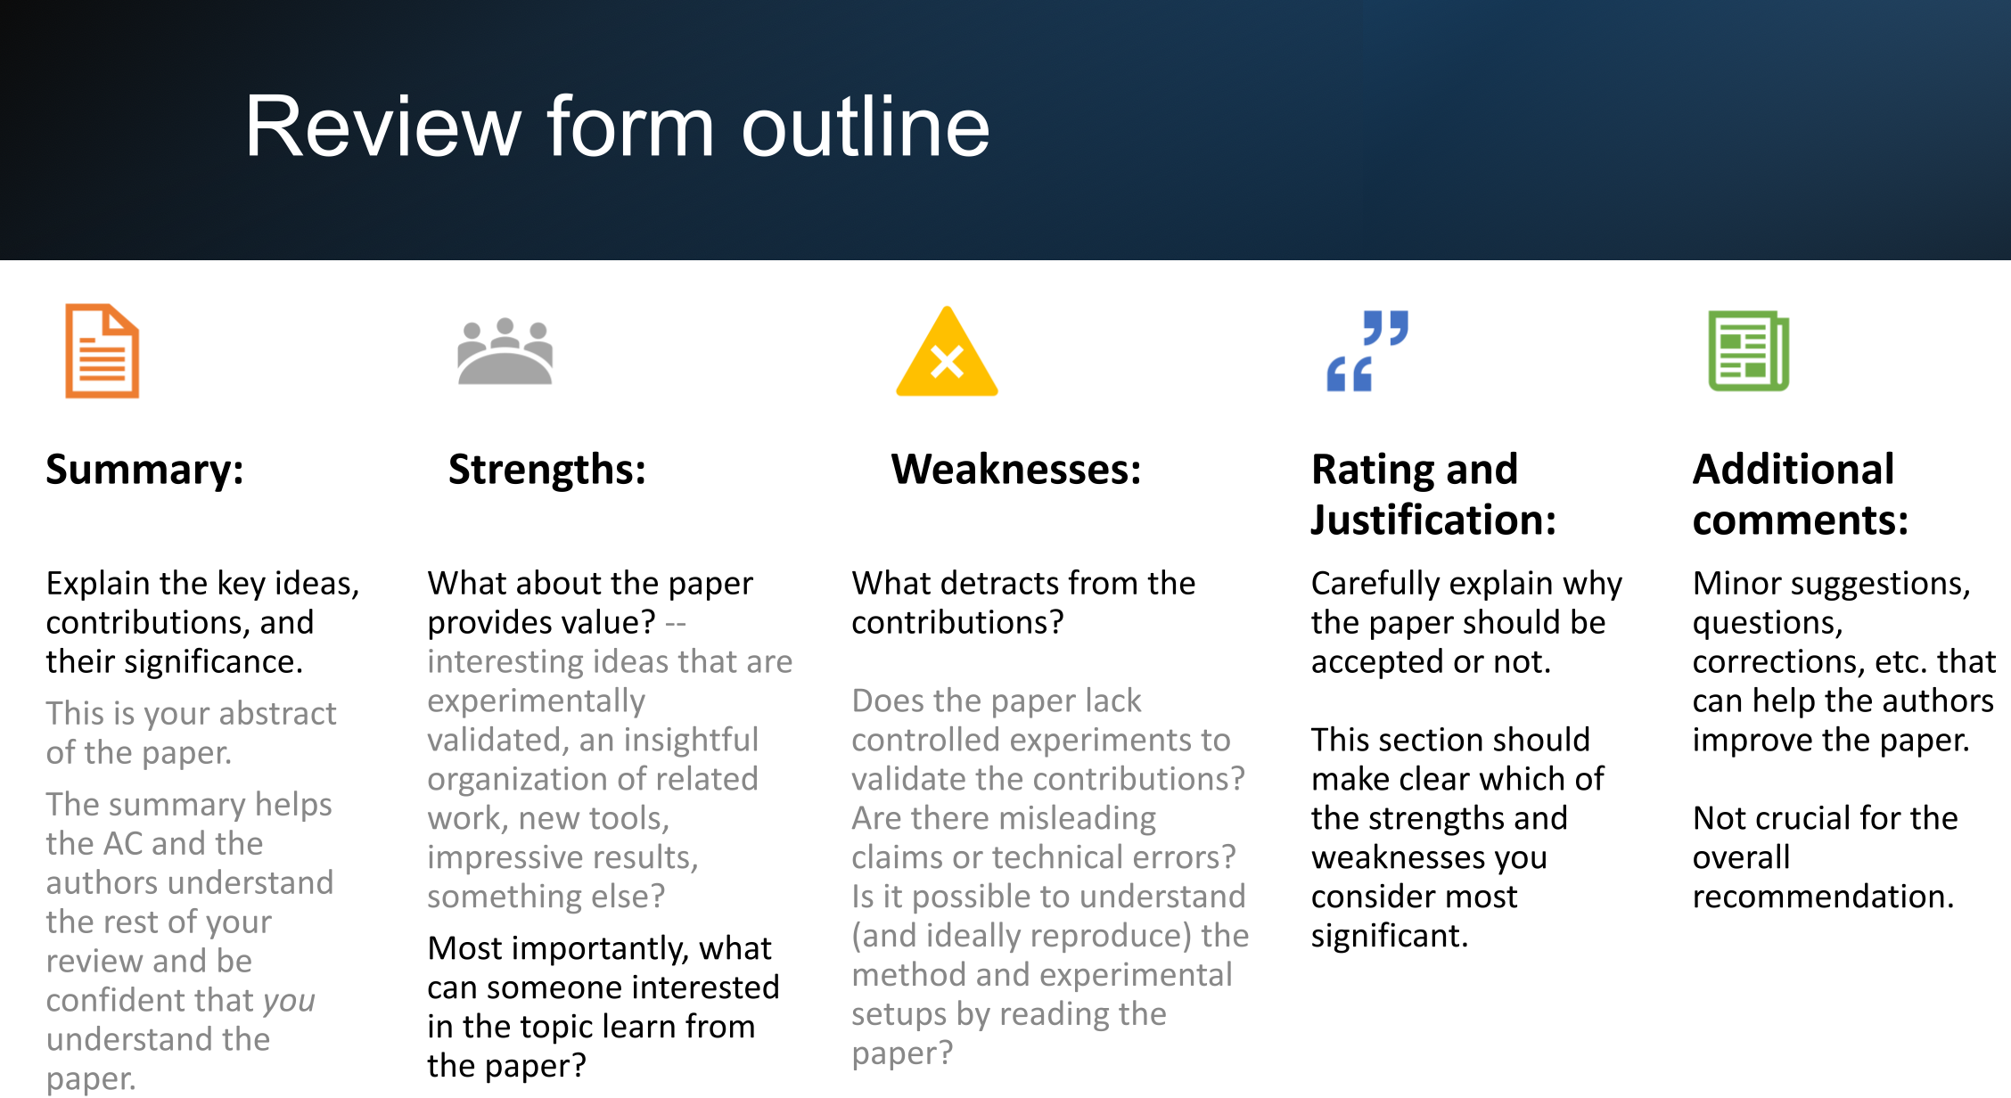
From “How to write a good review?”, CVPR workshop 2024

Slide 24
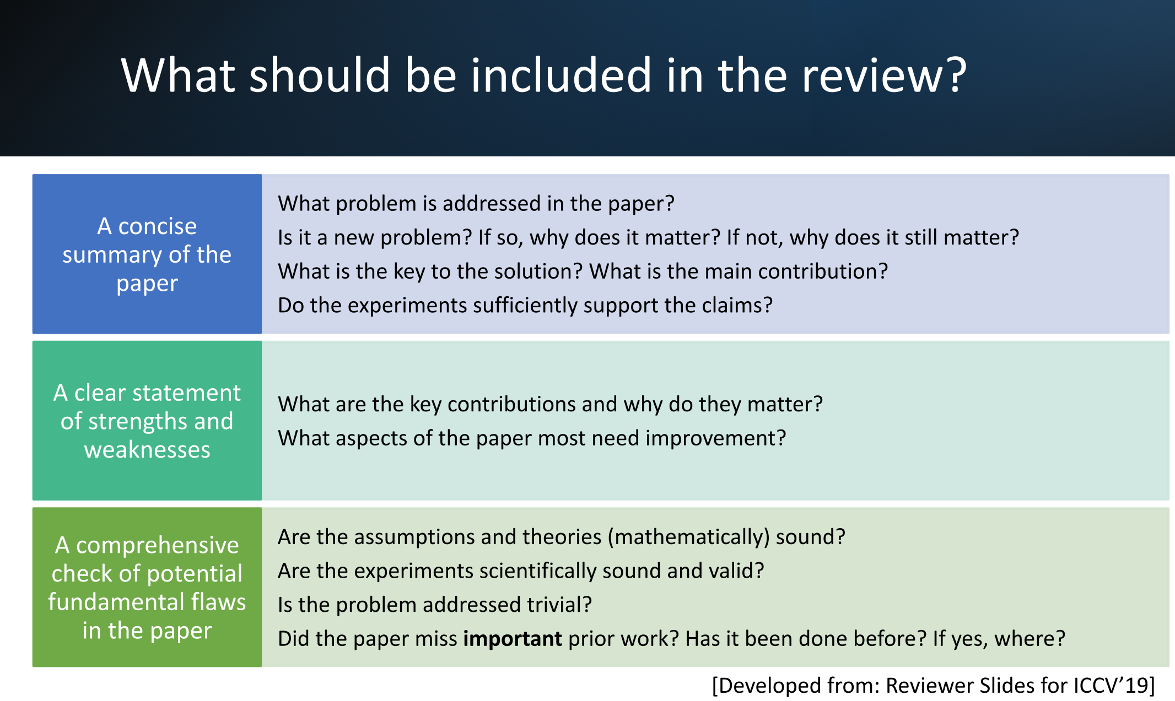

Slide 25
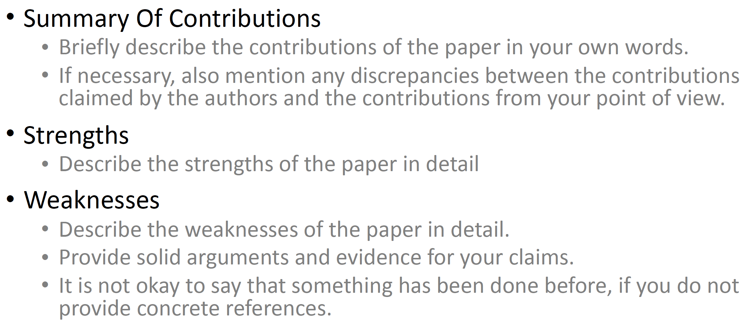
Anatomy of a Good* Review
Useful feedback, even if not positive
From Richard Szeliski, “How to write a good review?”, CVPR workshop 2020

Slide 26
Anatomy of a Good* Review
Useful feedback, even if not positive
Organize your response - sections for strengths, weaknesses, recommendations.
Language/Tone - write about the paper, not the author(s). And be nice!
Justify your response - if it’s been done already, cite that paper. If the writing is unclear, refer to a specific section.
Be generous about giving the authors new ideas for how they can improve their work.
You might suggest a new technical tool that could help, a dataset that could be tried, an application area that might benefit from their work, or a way to generalize their idea to increase its impact.
From “How to write a good review?”, CVPR workshop 2024

Slide 27
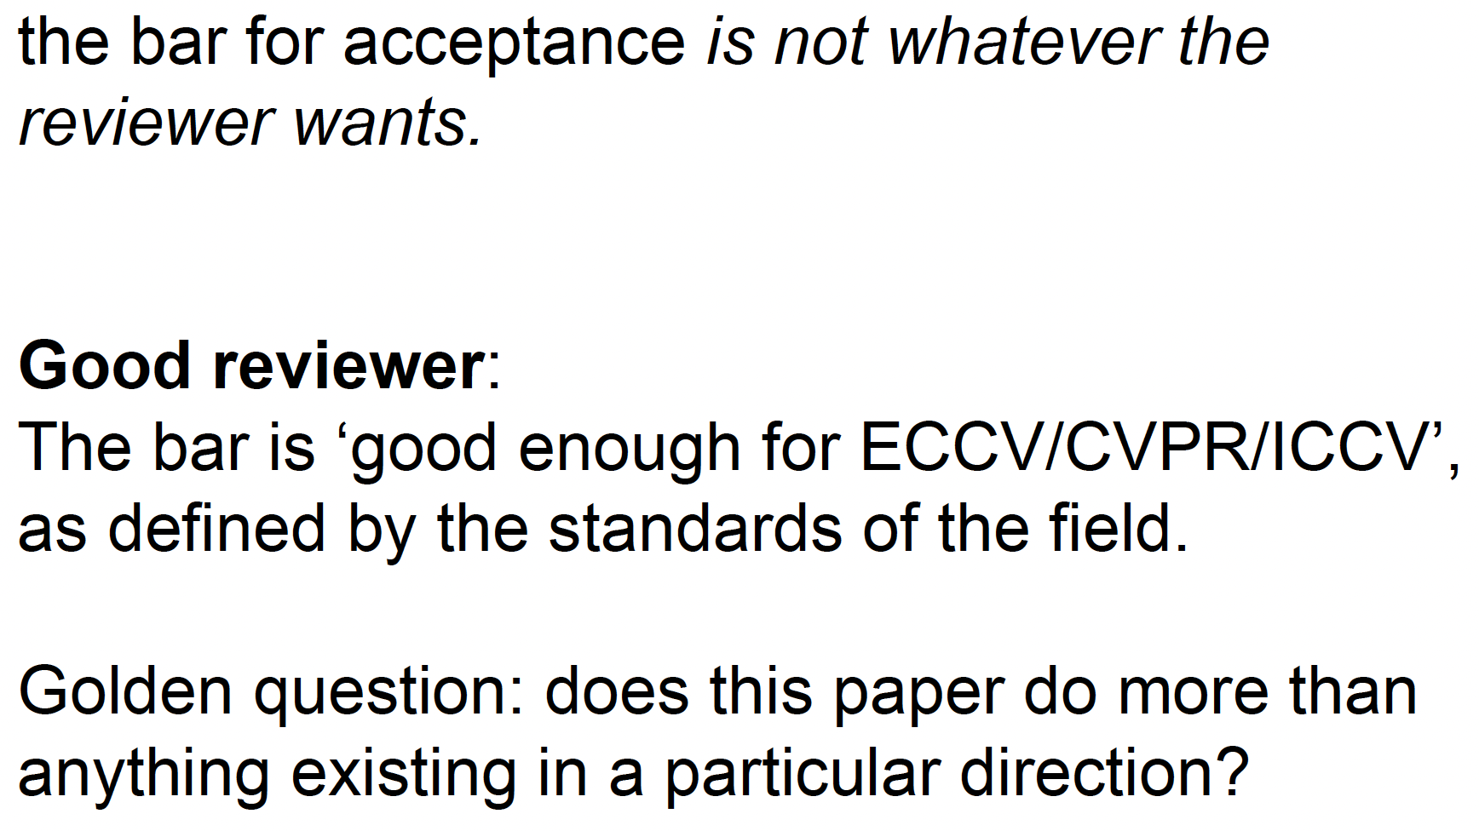
Anatomy of a Good* Review
Useful feedback, even if not positive
From Vittorio Ferrari, “How to write a good review?”, CVPR workshop 2020

Slide 28
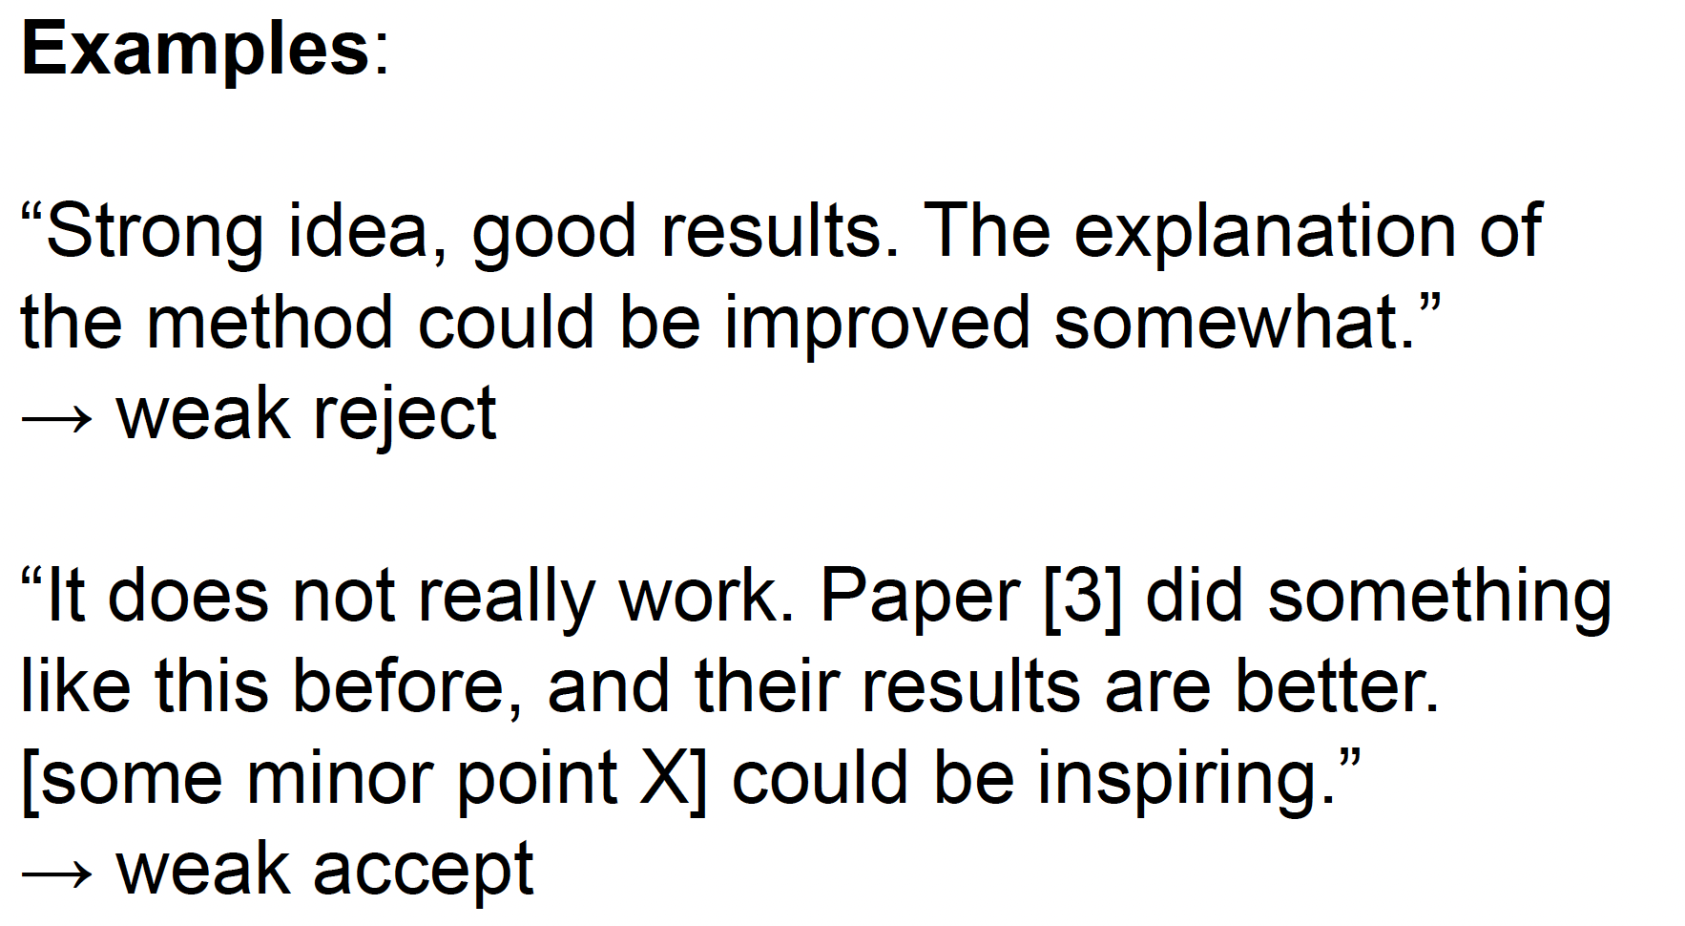
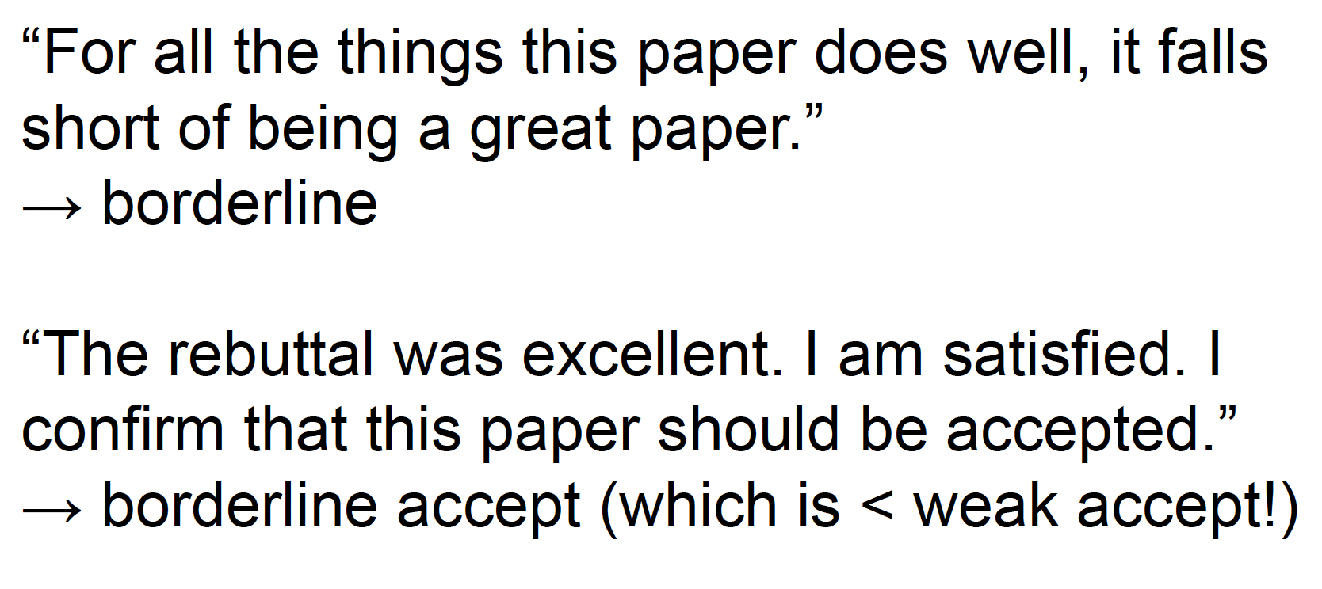
Anatomy of a Bad* Review
Useless feedback, even if positive
From Vittorio Ferrari, “How to write a good review?”, CVPR workshop 2020

Slide 29
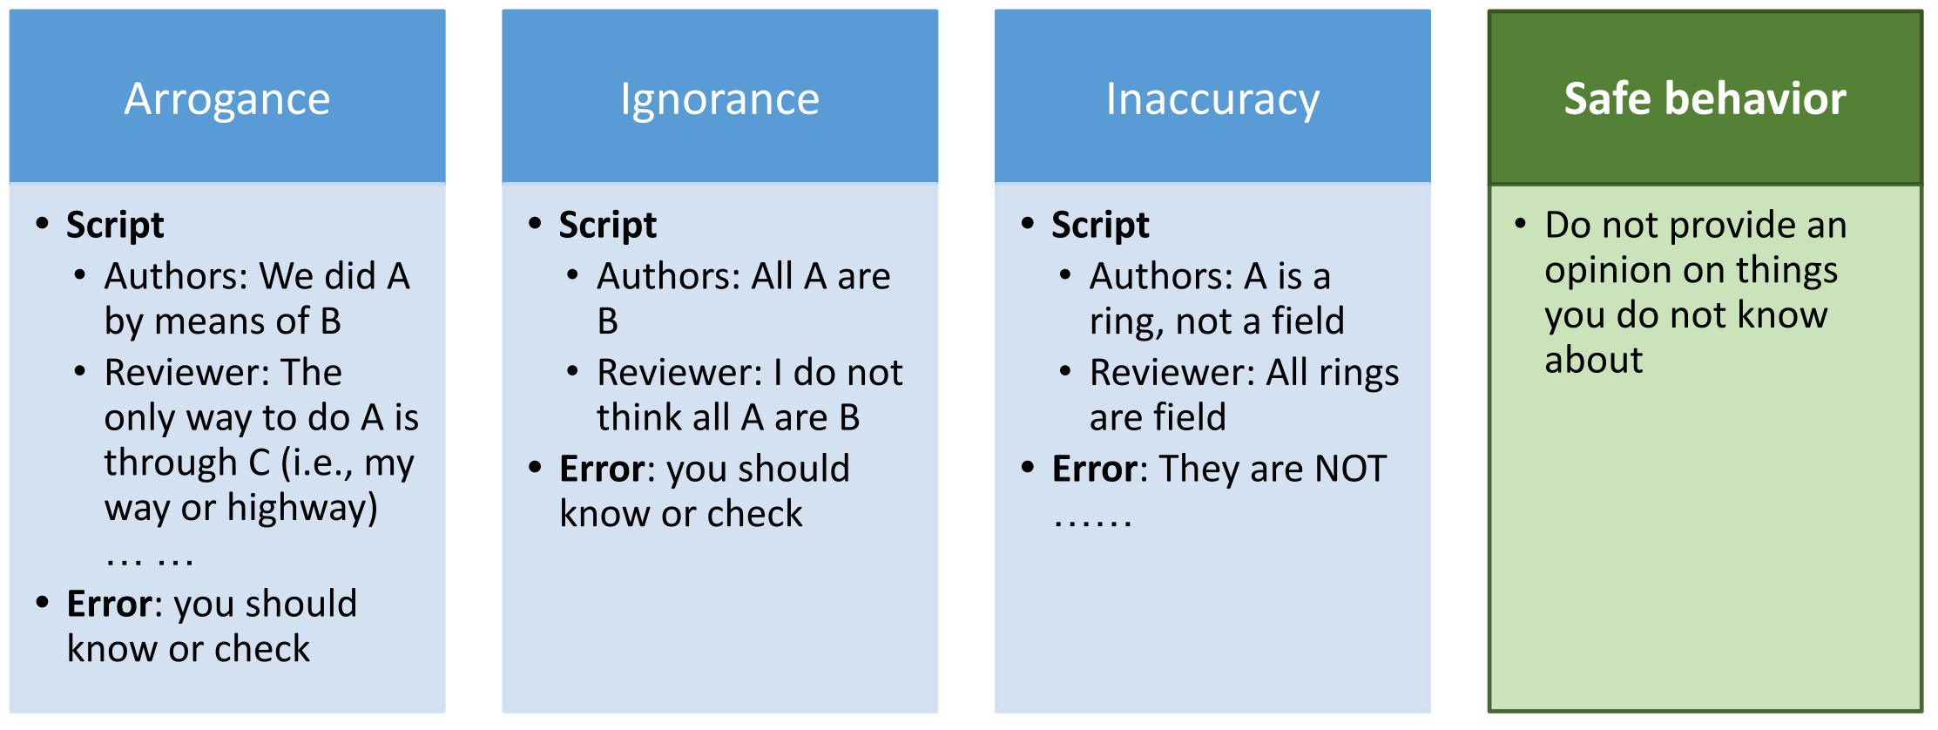
Anatomy of a Bad* Review
Useless feedback, even if positive

Slide 30
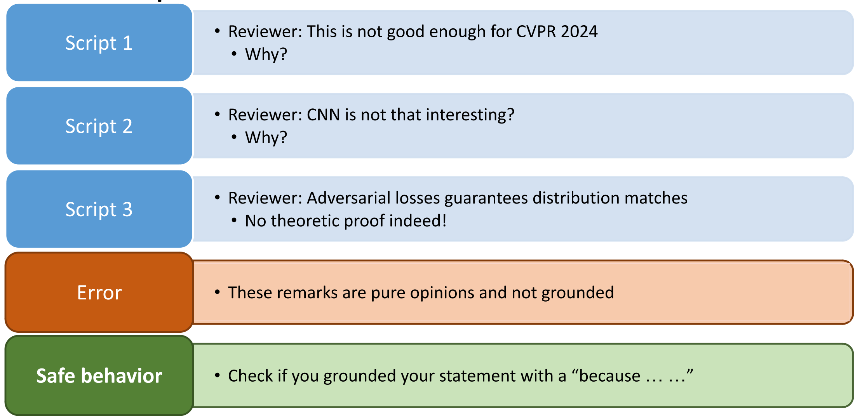
Anatomy of a Bad* Review
Useless feedback, even if positive

Slide 31
Examples of Reviews

Slide 32
Examples of Reviews
From recent conferences
The following reviews are published in the public domain from ICLR (International Conference on Learning Representations).
ICLR format is single narrative, no bullets or sections.
We can evaluate the quality of the review alone:

Slide 33
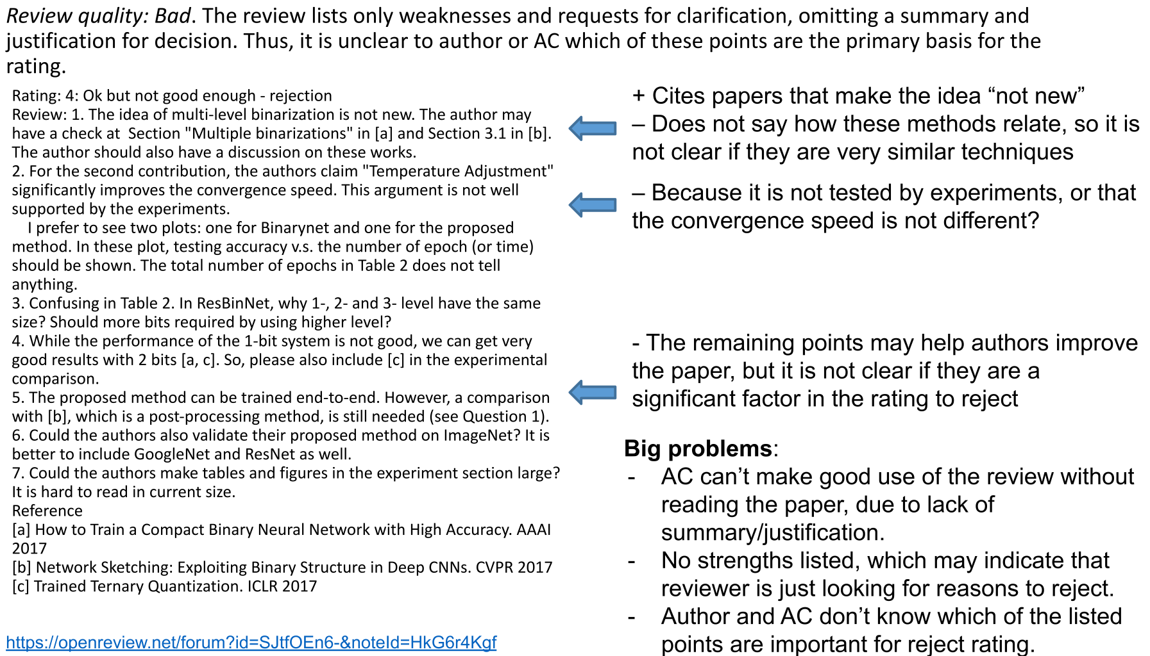

Slide 34
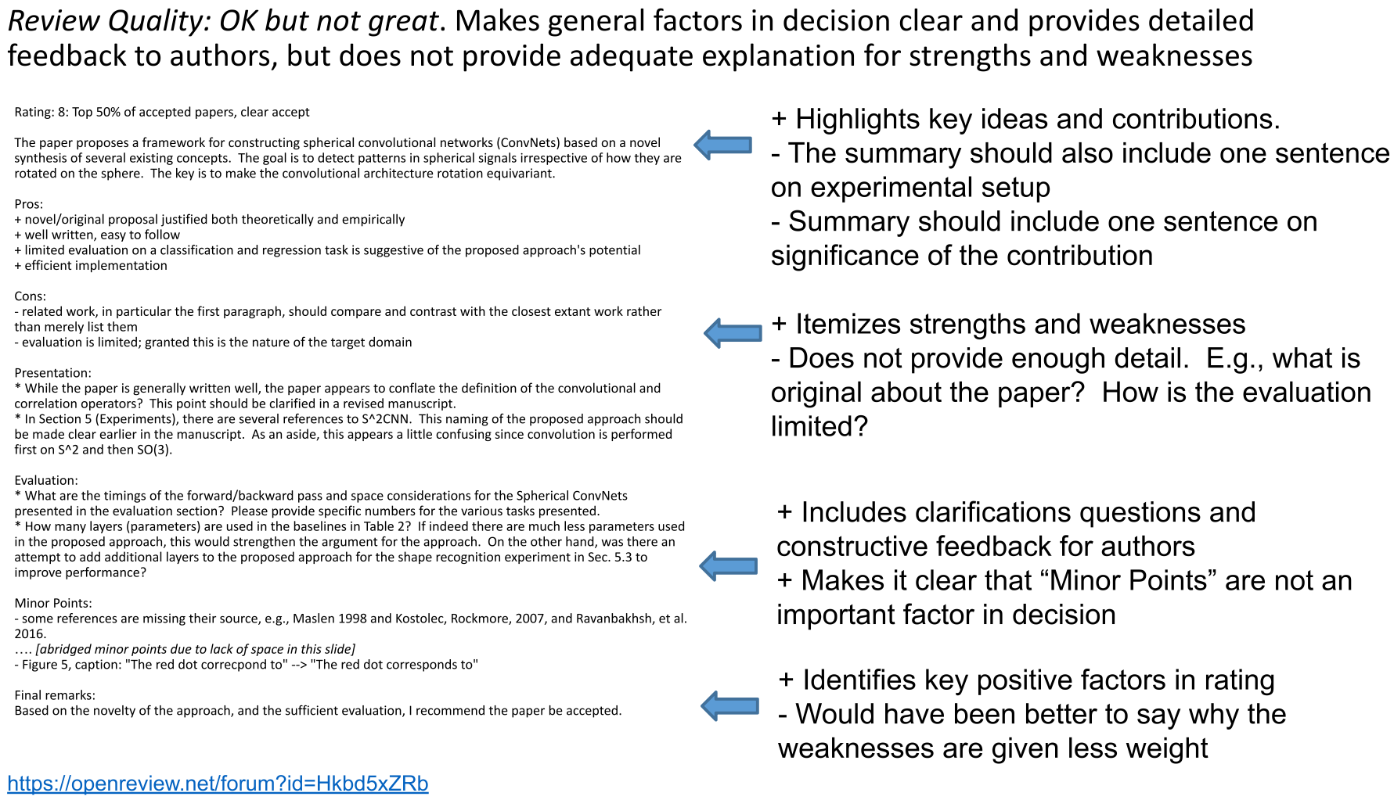

Slide 35
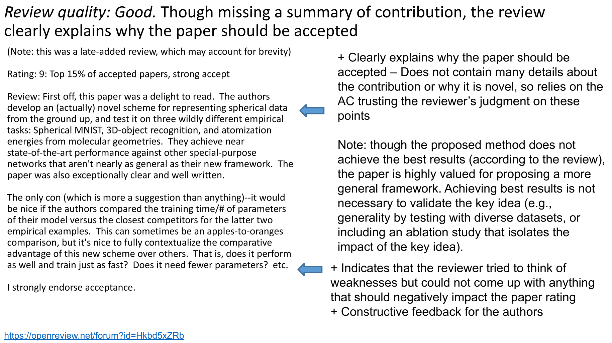

Slide 36
Q&A

Slide 37
Wrap-Up
Tuesday
Understand the peer review process for publishing research
Learn from expert(s) in diverse fields within CS
To Do:
Guest Lecture Survey (in-class Thursday)
See you Thursday!

Slide 38
Guest Research Lecture:
Dr. Ke Yang

Slide 39
Wrap-Up
Thursday
Understand the peer review process for publishing research
Learn from expert(s) in diverse fields within CS
To Do:
Guest Lecture Survey (in-class Thursday)
See you next week!

